Slide 1


Impact of Social Sciences, Humanities and Arts Conference
The Parallel Session on:
Evidence-informed Policy Making
14 October, 2021

Slide 2


Impact of Social Sciences, Humanities and Arts
13-15 October, 2021
Nicola Francesco Dotti (Chair): Senior Researcher in the ECOOM unit, Vrije Universiteit Brussel (VUB), Belgium
Antti Pelkonen: Science Advisor, Prime Minister’s Office in Finland
Tracey Brown: Director of Sense about Science, London, United Kingdom
Lorenzo Melchor Fernandez: Policy Analyst at the European Commission
Overview of the Speakers
#SSHA21

Slide 3
Impact of Social Sciences, Humanities and Arts
13-15 October, 2021
Nicola Francesco Dotti
Senior Researcher in the ECOOM unit, Vrije Universiteit Brussel (VUB), Belgium
#SSHA21

Slide 4
TRACKING POLICY IMPACTS USING OVERTON.io AN EXPLORATIVE ANALYSIS
Nicola Francesco DOTTI (ECOOM – VUB)
AESIS Conference
14/Oct/2021

Slide 5
OUTLINE
FOR THE ASSESSMENT OF THE SOCIETAL IMPACT OF UNIVERSITY RESEARCH (SIUR): THE CASE OF POLICY IMPACTS
WHAT IS OVERTON.io?
THE CASE OF THE GOVERNMENT OF FLANDERS: AN EXPLORATIVE ANALYSIS
POTENTIALS & LIMITATIONS
CONCLUSIONS

Slide 6
1.
FOR THE ASSESSMENT OF
THE SOCIETAL IMPACT OF UNIVERSITY RESEARCH (SIUR)
THE CASE OF POLICY IMPACTS

Slide 7
A VISUAL, CONCEPTUAL MAP
The context
SOCIETAL CHALLENGES
RESEARCH-INFORMED
POLICY
???
GOVERNMENT
SCIENTIFIC
PUBLICATIONS
POLICY-RELEVANT RESEARCH
ACADEMIC IMPACT
From-scholars-to-scholars
POLICY IMPACT
From-scholars-to-government
UNIVERSITY
…
TECHNOLOGY TRANSFER
FIRMS
MARKET
TECHNO-ECONOMIC IMPACTS
From-scholars-to-market

Slide 8
A VISUAL, CONCEPTUAL MAP
The context
SOCIETAL CHALLENGES
RESEARCH-INFORMED
POLICY
GOVERNMENT
SCIENTIFIC
PUBLICATIONS
POLICY-RELEVANT RESEARCH
ACADEMIC IMPACT
From-scholars-to-scholars
POLICY IMPACT
From-scholars-to-government
UNIVERSITY
…
TECHNOLOGY TRANSFER
FIRMS
MARKET
TECHNO-ECONOMIC IMPACTS
From-scholars-to-market

Slide 9
POLICY IMPACTS
OUR FOCUS
CITATIONS
FROM POLICY DOCUMENTS TO UNIVERSITY RESEARCH
= FORMAL ACKNOWLEDGEMENTS BY DECISION-MAKERS
OF A POLICY-RELEVANT SCIENTIFIC PUBLICATION
UNIVERSITY AS ‘KNOWLEDGE SUPPLIER’ FOR DECISION-MAKERS

Slide 10
2.
WHAT IS OVERTON.io?
AN ARCHIVE OF POLICY DOCUMENTS LINKED WITH SCIENTIFIC PUBLICATIONS

Slide 11
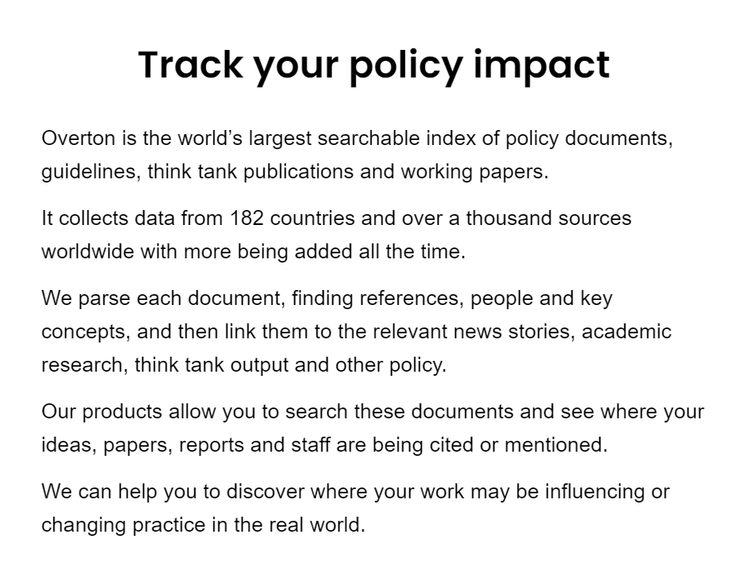
What is Overton.io?
A new data source
A DATABASE OF POLICY DOCUMENTS LAUNCHED IN SEPT/2019
POSSIBILITY TO ADD POLICY ARCHIVES
SCIENTIFIC PUBLICATIONS SOURCE: MICROSOFT ACADEMIC
LANGUAGES:
ENGLISH, CHINESE, DUTCH, FRENCH, GERMAN, ITALIAN, JAPANESE, POLISH, PORTUGUESE, RUSSIAN, SPANISH, SWEDISH, FINNISH, DANISH, NORWEGIAN.
SOURCE: Overton website

Slide 12
OVERTON SOURCES FROM BELGIUM
THINK TANK | ITEMS
Bruegel | 706
Business Europe | 4,246
Ceemet | 102
CEPS | 2,725
Digital Europe | 151
ECIPE | 529
ECVET | 9
EEFE | 93
Egmont Institute | 822
ETUCE | 268
EUROCHAMBRES | 114
European Policy Centre | 645
European Schoolnet | 165
European Trade Union Confederation | 1,274
European Trade Union Institute | 1,724
Friends of Europe | 1,393
Institute for European Environmental Policy | 1,203
Institute for European Studies | 94
International Crisis Group | 204
Itinera | 2,357
Lifelong Learning Platform | 23
Lisbon Council | 105
Open Europe | 10
OpenForum Europe | 112
Science Europe | 83
SMEUnited | 144
SOLIDAR | 346
Uni Europa | 103
TOTAL | 19,750
Governments and Think Tanks
GOVERNMENT
Belgian Court of Audit | 2,558
Belgian Federal Public Services | 3,956
Belgian Health Care Knowledge Centre | 656
BELSPO | 109
City of Brussels | 185
ESFRI | 35
Federal Planning Bureau | 1,587
Federal Public Planning Service for Social Integration | 136
Government of Flanders | 15,648
Government of Wallonie-Bruxelles | 3,885
IBSA | 202
National Bank of Belgium | 407
Sciensano | 345
TOTAL | 29,709

Slide 13
3.
THE CASE OF THE GOVERNMENT OF FLANDERS
AN EXPLORATIVE ANALYSIS

Slide 14

POLICY DOCUMENTS FROM GOV.FLANDERS
FLEMISH UNIV. x
TRACKING OF CITATIONS/MENTIONS
GOV.FLANDERS
POLICY DOCUMENTS
FLEMISH UNIV. y
OTHER POLICY SOURCES
OTHER BELGIAN UNIV./INSTITUTE
REFERENCES UNAVAILABLE
FULL TEXT UNAVAILABE
OTHER NON-BELGIAN UNIV./INST.
TAXONOMY NON EXHAUSTIVE

Slide 15
POLICY DOCUMENTS FROM GOV.FLANDERS
FLEMISH UNIV. x
TRACKING OF CITATIONS/MENTIONS
GOV.FLANDERS
POLICY DOCUMENTS
FLEMISH UNIV. y
OTHER POLICY SOURCES
OTHER BELGIAN UNIV/INSTITUTE
REFERENCES UNAVAILABLE
FULL TEXT UNAVAILABE
OTHER NON-BELGIAN UNIV./INST.
TAXONOMY NON EXHAUSTIVE

Slide 16
POLICY DOCUMENTS FROM GOV.FLANDERS
COAUTHORSHIPS IN CITED/MENTIONED POLICY DOCS
 | UG | KUL | UA | VUB | UH
UG |  | 266 | 225 | 169 | 22
KUL | 266 |  | 165 | 104 | 18
UA | 225 | 165 |  | 120 | 15
VUB | 169 | 104 | 120 |  | 10
UH | 22 | 18 | 15 | 10
 | 682 | 553 | 525 | 403 | 65
 | UG | KUL | UA | VUB | UH
UG |  | 48% | 43% | 42% | 34%
KUL | 39% |  | 31% | 26% | 28%
UA | 33% | 30% |  | 30% | 23%
VUB | 25% | 19% | 23% |  | 15%
UH | 3% | 3% | 3% | 2%
 | 100% | 100% | 100% | 100% | 100%
COAUTHORSHIPS AMONG CITED PUBLICATIONS
POLICY DOCUMENTS CITING FLEMISH UNIV | Total | UG | KUL | UA | VUB | UH
Citing 1 Flemish. University | 709 | 347 | 201 | 112 | 49 | 0
Citing 2 Fl. Univ. | 283 | 216 | 167 | 110 | 68 | 5
Citing 3 Fl. Univ. | 145 | 137 | 100 | 113 | 76 | 9
Citing 4 Fl. Univ. | 56 | 56 | 54 | 55 | 53 | 6
Citing 5 Univ. | 6 | 6 | 6 | 6 | 6 | 6
TOTAL | 1,199 | 762 | 528 | 396 | 252 | 26

Slide 17
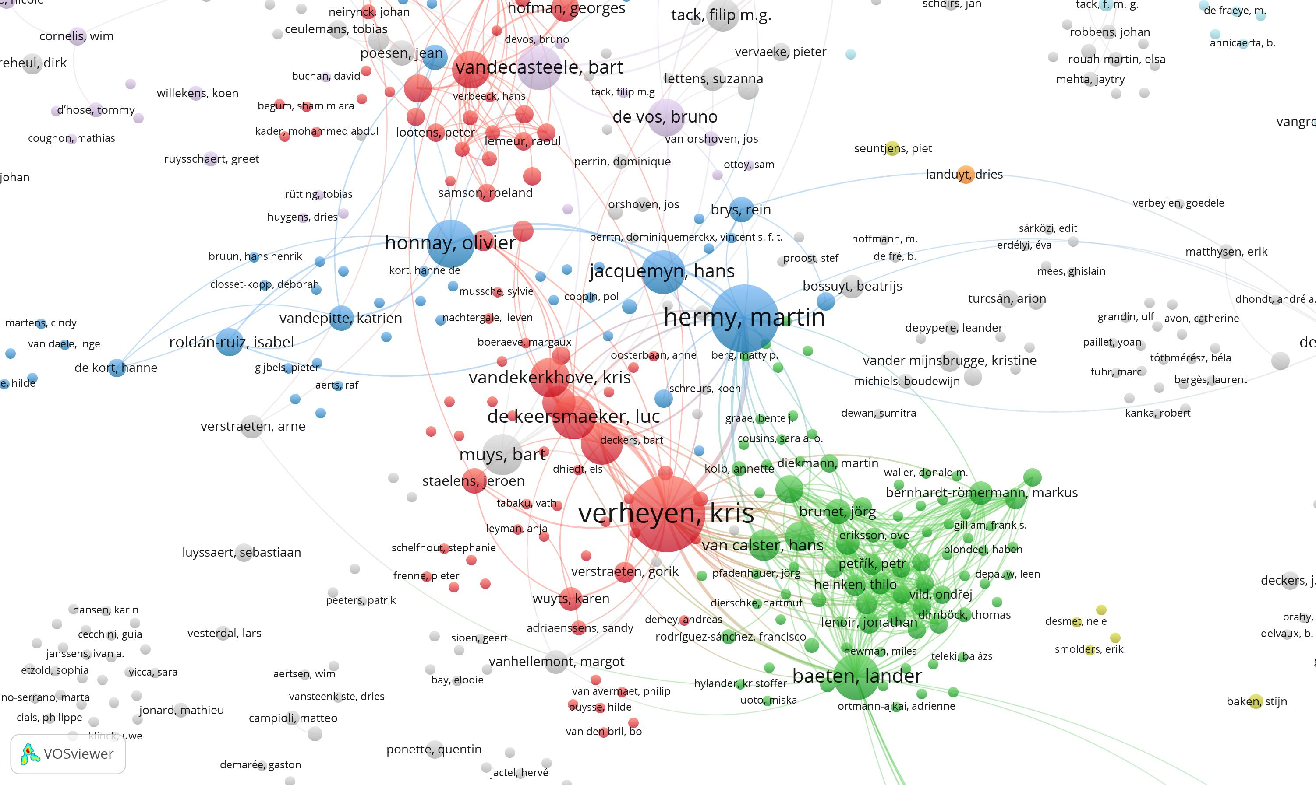
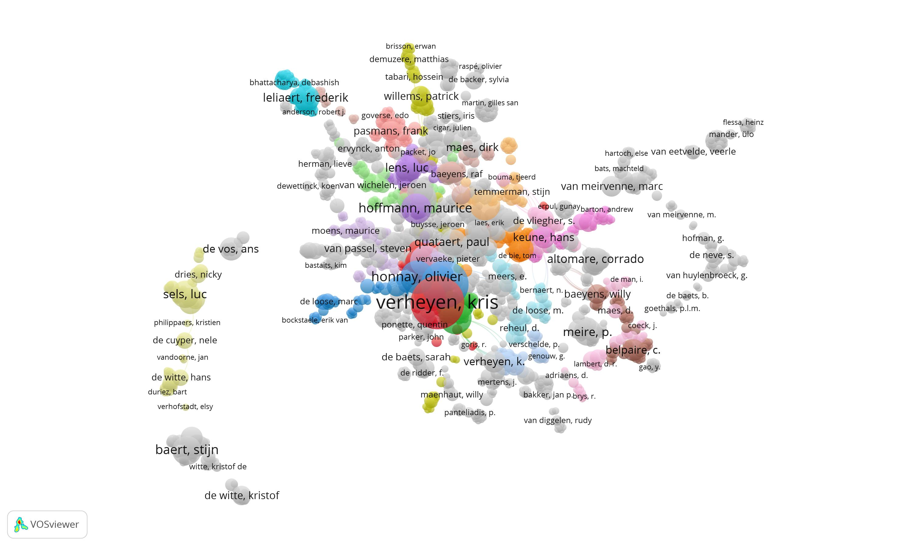
ACTIVE FLEMISH SCHOLARS CITED IN DOCUMENTS FROM GOV.FLANDERS
COAUTHORSHIP NETWORK

Slide 18
POLICY DOCUMENTS FROM GOV.FLANDERS
TRACKING OF CITATIONS/MENTIONS
FRIS
OVERTON.io
INSTITUTIONAL AFFILIATION OF ACTIVE SCHOLARS
(Dept.)
GOV.FLANDERS
POLICY DOCUMENTS
SCHOLARS IN FLEMISH UNIV.
DISCIPLINARY CLASSIFICATION
(adapted from Glanzel & Schubert 203)

Slide 19
POLICY CITATIONS
NUMBER OF CITATIONS FROM GOV.FLANDERS TO ACTIVE FLEMISH SCHOLARS
DISCIPLINES FOR ACTIVE FLEMISH SCHOLARS BASED ON AN ADAPTION OF GLANZEL & SCHUBERT (2003)
BLOCK-1: NUMBER OF CITATIONS FROM GOV.FLANDERS TO ACTIVE FLEMISH SCHOLARS
BLOCK-2: UNIVERSITY CITATIONS WEIGHTED BY DISCIPLINARY AVERAGE

Slide 20
5.
CONCLUSIONS
OPEN QUESTIONS AND NEXT STEPS

Slide 21
FROM ANALYSING THE CASE OF GOV.FLANDERS IN OVERTON
KEY FINDINGS & LIMITATIONS
KEY FINDINGS
OVERTON CAN TRACK CITATIONS FROM POLICY DOCUMENTS TO SCIENTIFIC PUBLICATIONS
=> A POSSIBLE INDICATOR TO MEASURE THE SOCIETAL IMPACT OF UNIVERSITY RESEARCH
IN FLANDERS (BELGIUM), EACH DISCIPLINE AND UNIVERSITY SHOW DIFFERENT CITATIONS PATTERN THAT CAN BE TRACKED/MEASURED
LIMITATIONS
CITATION ISSUES LIKE IN BIBLIOMETRICS
(e.g. NEED FOR A BENCHMARK VALUE TO ‘WEIGHT’ THEM, e.g. EACH DISCIPLINE IS SPECIFIC)
GOV.FLANDERS IS NOT THE ONLY RELEVANT POLICY-MAKERS
=> OVERTON CAN TRACK OTHER POLICY ARCHIVES
(E.G. FEDERAL GOV., EU COMMISSION, OECD…)

Slide 22
OPEN FOR DISCUSSIONS
TRACKING CITATIONS FROM POLICY DOCUMENTS
WHAT IS THE VALUE OF BEING CITED
BY POLICY DOCUMENTS?
HOW TO ASSESS/EVALUATE POLICY IMPACTS?
Notes:
We need theory of action and theory in action

Slide 23
Thanks for your attention
Nicola Francesco Dotti
Nicola.Dotti@vub.be ~ www.nfdotti.me
(Twitter) @NFDotti

Slide 24
Impact of Social Sciences, Humanities and Arts
13-15 October, 2021
Antti Pelkonen
Science Advisor, Prime Minister’s Office in Finland
#SSHA21

Slide 25
COVID-19 Research Review –
A new science advice instrument during the COVID-19 pandemic in Finland
October 2021 I AESIS Conference
Dr. Antti Pelkonen
Science Specialist
Prime Minister’s Office, Finland

Slide 26
This presentation
Some features of science advice in Finland during the COVID-19 pandemic
COVID-19 Research Review as new science advice instrument

Slide 27
Government science advice in Finland in the COVID-19 pandemic – Some features
The pandemic has globally challenged science advice systems in an unprecented way – also in Finland
Globally common challenges: lack of scientific knowledge, uncertainty related to the available knowledge; questions related to transparency and openness of science advice etc.
Throughout the pandemic the Finnish Government has emphasized the role of expert knowledge (e.g. Deloitte 2021), but has not in each decision followed the recommendations.
The Finnish Institute for Health and Welfare (epidemiology, modelling, health issues) in a key position
  Lack of a more encompassing knowledge base: perspectives on the economy, employment, social and legal issues (at least during the first half of 2020; (Deloitte 2021).
Notes:
➔who acts as advisor, what is the knowledge base and how independent the advice is.
G’ment relied on ”overall socio-political judgement”
Moni- ja poikkitieteellisyys jäänyt vähemmälle
THL:llä ja epidemiologeilla ollut keskeinen rooli – tässäkin ehkä yhdellä ryhmällä vahva rooli – Kuka saa äänensä kuuluville?
Salminen tiedekulmassa: kokenut että THL:n asiantuntemusta haastettu vahvasti, etenkin alussa ja pitäisi vahvistaa THL:n ja yliopistojen välistä yhteyttä. Aiemmat rahoitusleikkaukset olleet THL:lle hankalia ja ovat näkyneet.
Epidemiologinen näkökulma ollut päällimmäinen, päättäjien itse arvioivat että perusoikeudellinen, taloudellinen ja sosiaalinen näkökulma jäi vähemmälle keväällä. Tämä luultavasti heijastunut tiedeneuvonannossa.
large pool of researchers and various experts offering their views and expertise etc.

Slide 28
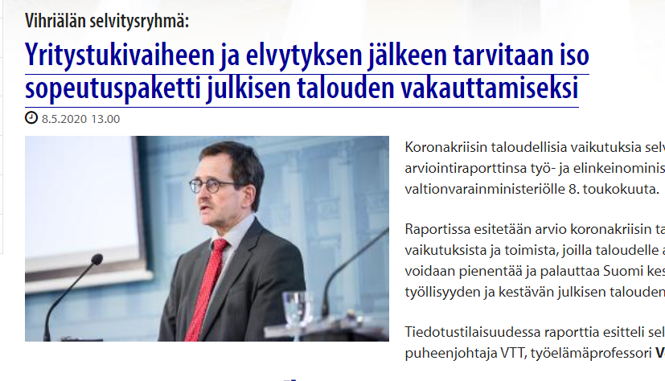


Government science advice in Finland during the COVID-19 pandemic – Some activities
Epidemiology, medicine
  Epidemiological modelling group (as of 8.4.2020)
Economics
  Expert report report on economic strategy (5/2020)
  Economic ”Situation Room”; Helsinki Graduate School of Economics’ (since 4/2020)
Behavioural sciences
  Behavioural science advice working group (11/2020-3/2021; continued;)
Multidisciplinary
  COVID-19 scientific panel (4-6/2020)
  COVID-19 research reviews (since 8/2020 - )
  COVID-19 scenarios (12/2020 -; foresight, economics, epidemiology)
Other mechanisms (e.g. commissioned short reports, ”expert papers”, systematic review on face masks 6/2020; working groups)
Notes:
Large part of science advice takes place ”behind the scenes”, these are some visible activities

Slide 29

How to screen the most relevant studies releted to COVID-19 and to convey their messages to policy-makers and decision-makers?

Slide 30

COVID-19 Research Review…
… compiles latest research results related to various dimensions of the COVID-19 crisis,
… employs a cross-disciplinary team of leading Finnish scientists that screens research and selects studies to be included in each review,
… presents the studies in a concise and informative manner,
… provides decision-makers with cumulative insights into the latest and most relevant research results related to the crisis.

Slide 31
Multidisciplinary and cumulative outlook into the latest research
The review covers 11 thematic areas
Started in August 2020, it has been published every 2-5 weeks by the Prime Minister’s Office.
Distributed by email, available on the web and anyone can subscribe to it.
Primarily intended for use by political decision-makers and civil servants.
  Sent to all members of the Government, special advisers, permanent secretaries and widely across all ministries.
COVID-19 infection – Prof. Vapalahti, Ass. Prof. Sironen, Univ. Helsinki, & Senior Res. Fellow Pimenoff, Karolinska Institutet
Impact of restrictive measures on the spread of the epidemic – Prof. Auranen, Univ. of Turku, Chief Physician Leino, Finnish Institute for Health and Welfare
Impacts of the pandemic on welfare of the population – Res. Prof. Karvonen, Finnish Institute for Health and Welfare
Economy and business – Prof. Toivanen, Aalto University
Inequality (incl. employment) – Univ. Lecturer Ylöstalo, University of Turku
Education and learning – Prof. Vainikainen, Univ. of Tampere
Technology and innovations – Prof. Mäkinen, Univ. of Tampere
Environment and sustainable development – Adjunct Prof. Arponen, Univ. Helsinki
International relations, EU, security – Senior Res. Fellow Heinikoski, Finnish Institute of International Affairs
People, behaviour (incl. psychological resilience, social media and disinformation) – Professor of Practice Limnéll, Aalto University
Resilience, foresight – Prof. Salo, Aalto University

Slide 32
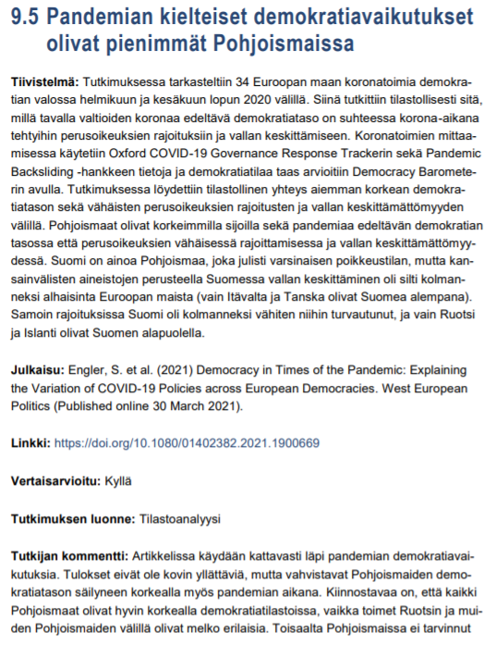
Each review includes summaries and analyses of 60-70 studies
An informative title summarising the main message of the study
Abstract
Bibliographical information of the publication
Link to the original publication
Information whether the study has been peer-reviewed or not
Short characterization of the study
Researcher’s comment on study

Slide 33

Impacts and feedback
19 reviews published, over 1 000 studies summarised and analysed
Over 2 000 subscribers, including a large number of key people involved in managing the COVID-19 situation in Finland.
Over 20 000 downloads in total (highest amount of downloads of a single review is over 5 000).
Positive feedback from political decision-makers, civil servants, experts etc.
The researchers of the group compiling the reviews have found the work beneficial for their own research work.

Slide 34
Further information
All reviews: https://tietokayttoon.fi/covid-19-tutkimuskatsaukset
Short article in English: https://tietokayttoon.fi/en/-/covid-19-research-review-provides-finnish-decision-makers-with-up-to-date-insights-into-science-on-the-pandemic

Slide 35
Thank you!
antti.pelkonen@gov.fi
@AnttiPelkonen

Slide 36
Impact of Social Sciences, Humanities and Arts
13-15 October, 2021
Tracey Brown
Director of Sense about Science, London, United Kingdom
#SSHA21

Slide 37
Tensions in evidence in policy
Tracey Brown

Slide 38
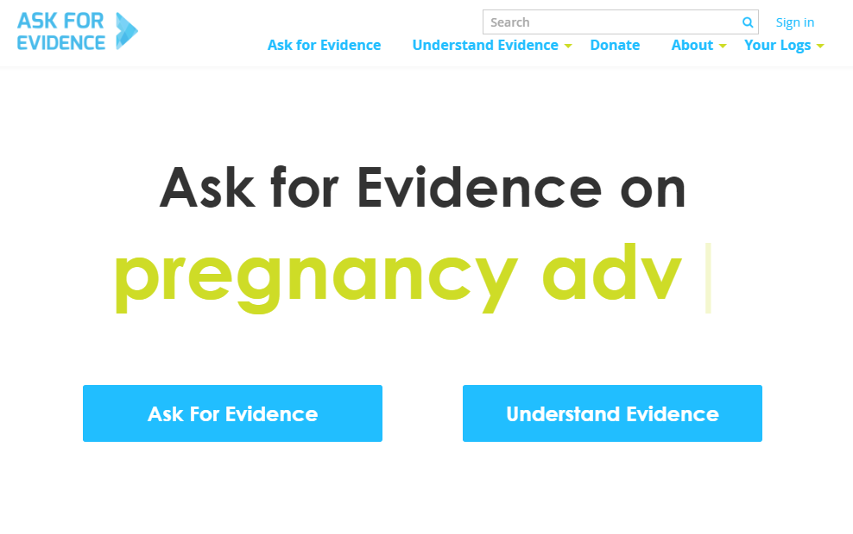

Slide 39
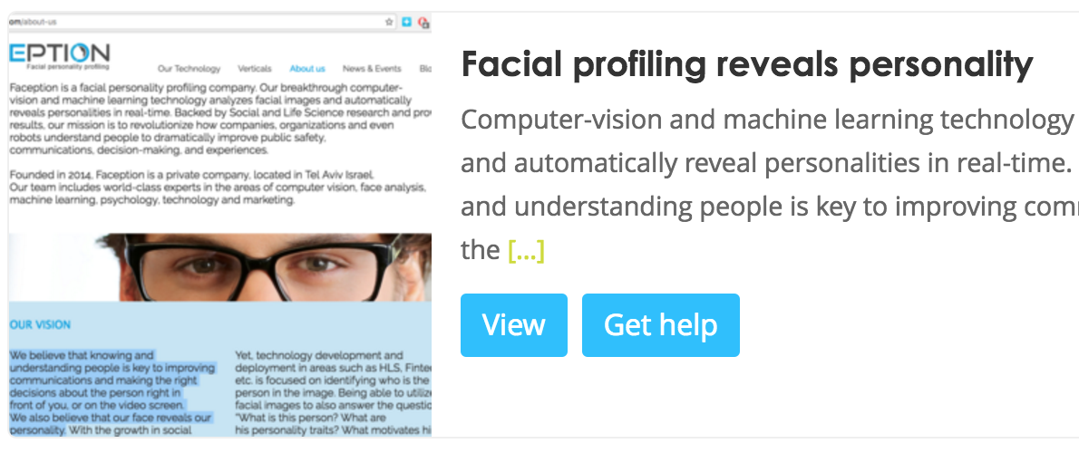

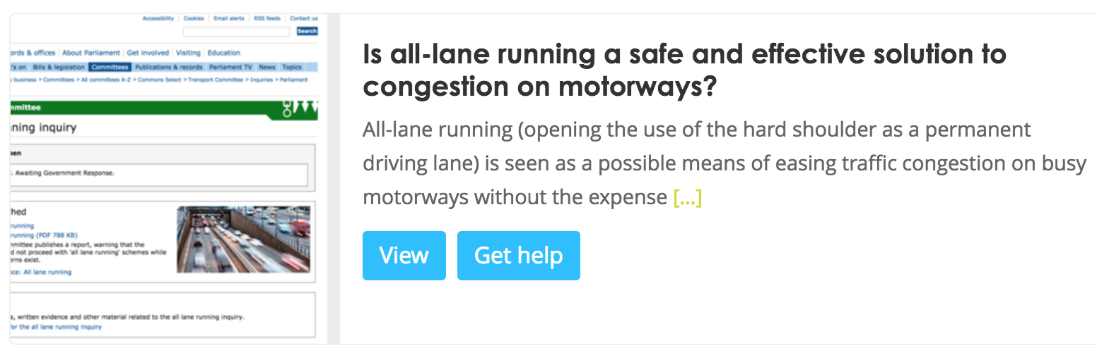


Slide 40
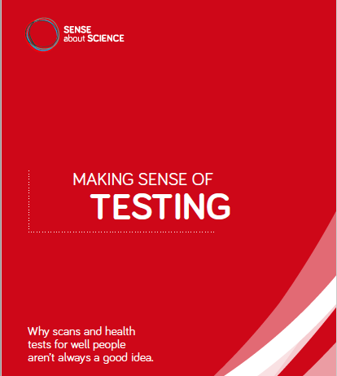

Slide 41
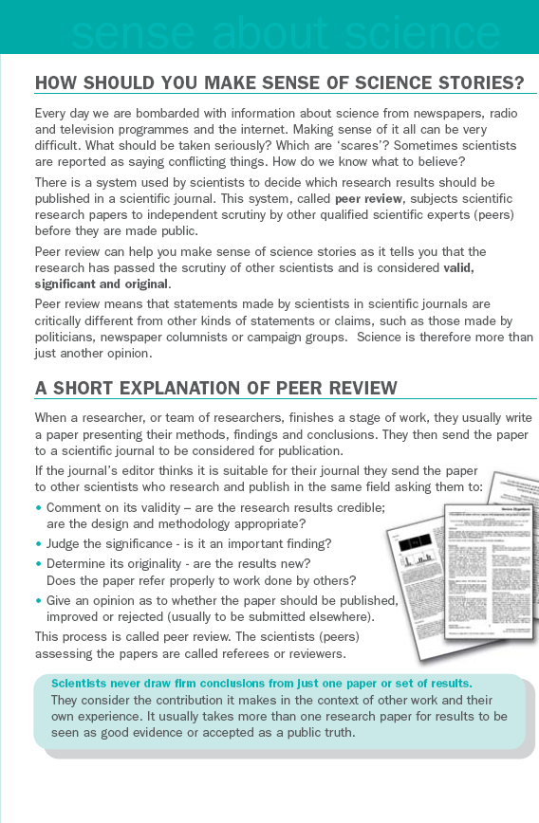


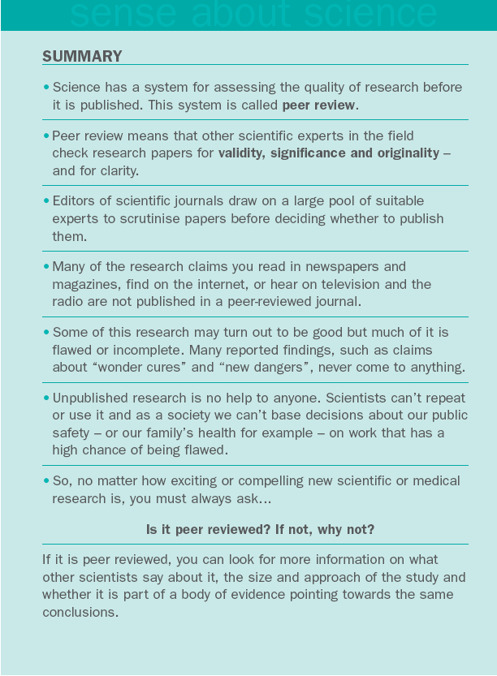


Slide 42
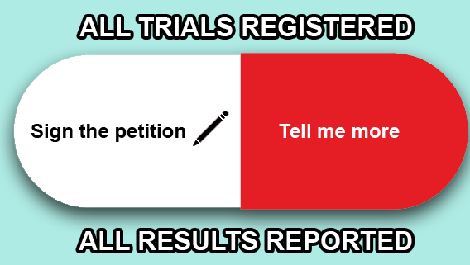

Slide 43
Principles for the Treatment of Independent Scientific Advice
Academic Freedom
Members of independent advisory groups are unpaid experts, most of whom have professional careers and reputations that depend on freedom to express their views openly and without restriction.
Independence of Operation
The ability to attract advisers of the highest quality, and public trust in the advisory system, depend on the actual and perceived independence of advisory bodies. This independence includes the right of advisors to publicly discuss evidence and advice that is not accepted by Government, within the constraints of professional conduct.
Proper Consideration of Advice
Evidence depends on the rigorous analysis of data; advice should be firmly based on evidence but inevitably reflects opinion and interpretation; policy may be influenced by considerations other than expert advice, but the evidence and advice provided by expert committees should be thoroughly and seriously considered by ministers.

Slide 44
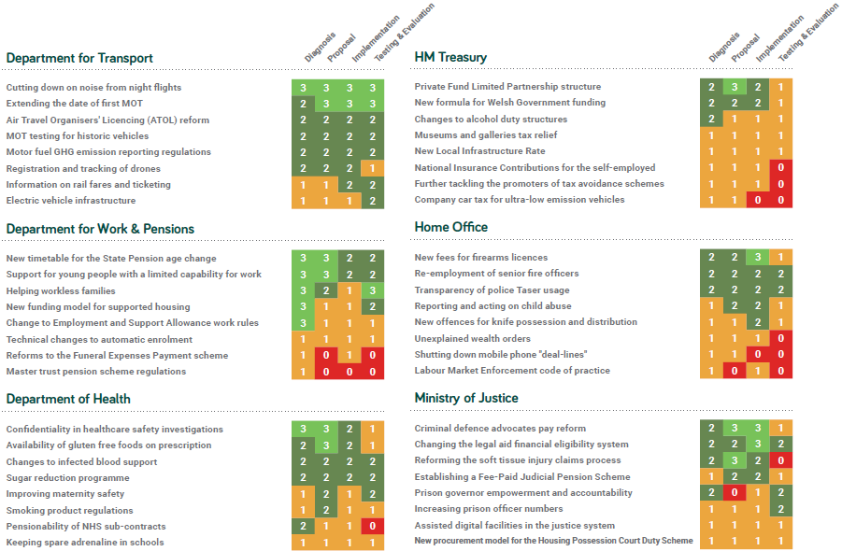

Slide 45

Findings
Departments don’t always share work that has been done.
Referencing needs to be more specific and useful.
The most transparent policies demonstrated a clear chain of reasoning.
Manifesto-derived policy commitments can be transparent.
Outcomes vs means
Budget announcements were among the least transparent.
A lot of scope to improve description of plans for testing and evaluation, and what consultations will do with inputs.
senseaboutscience.org/activities/transparency-evidence/
Notes:
1. Sharing work done
Departments should make available (and clearly reference) the research and reviews that they have conducted
to inform a policy, so that the public can understand the rationale for it.
2. Poor referencing
Referencing needs to be more specific and useful. Some policies linked to significant documents, showed clearly
which points were referenced to which sources and how these were relevant to the government’s conclusions.
Most didn’t. We couldn’t locate guidance on referencing for government documents, which might help.
3. A clear chain of reasoning
People should be able to follow the thinking between Diagnosis, Proposal, Implementation and Testing
& Evaluation. The most transparent proposals demonstrated the chain of reasoning as to what the problem was
and why the policy was the chosen response, and included discussion about the limitations of the evidence.
4. Manifesto-derived policy commitments can be transparent
Policies that originated in manifesto commitments featured among the best and the worst for transparency.
This seems to have been influenced by whether they are concerned with outcomes (ends) or with specific
measures to achieve them (means), and whether departments consulted on their development.
5. Budget announcements
Policies announced in the Budget or Autumn Statement were significantly less transparent about the underlying
evidence than other policies.
6. Alternatives
There was very little transparency overall about the consideration given to other policy options, even though this
is a requirement in impact assessments.
7. Modelling policy impacts
Some departments have found clear and impressive ways to share their modelling and the assumptions
behind models.
8. Testing and evaluation
There is a lot of scope to improve the description of plans for testing and evaluation and for what consultations
will do with inputs. Few policies scored well on this. Policies with clear testing and evaluation plans tended to be
clearer about the evidence for the scope and scale of the issues they were addressing.

Slide 46
Evidence transparency framework
Can someone outside government work out what the government is proposing to do, and why?
Diagnosis
This concerns why something is proposed, ie what the issue is that will be addressed.
Can you see what evidence has been used and the role it has played?
0
Not sufficiently for level 1.
1
Evidence is mentioned, with some explanation of how it has been used.
2
Supporting evidence, cited and findable, discussion of how it has been used.
3
Supporting evidence linked to relevant parts of policy, cited and findable, assessment of uncertainties and contradictions.
Worked example
The government has assessed the extent of problem drinking in the UK: the economic
and human cost.

Slide 47
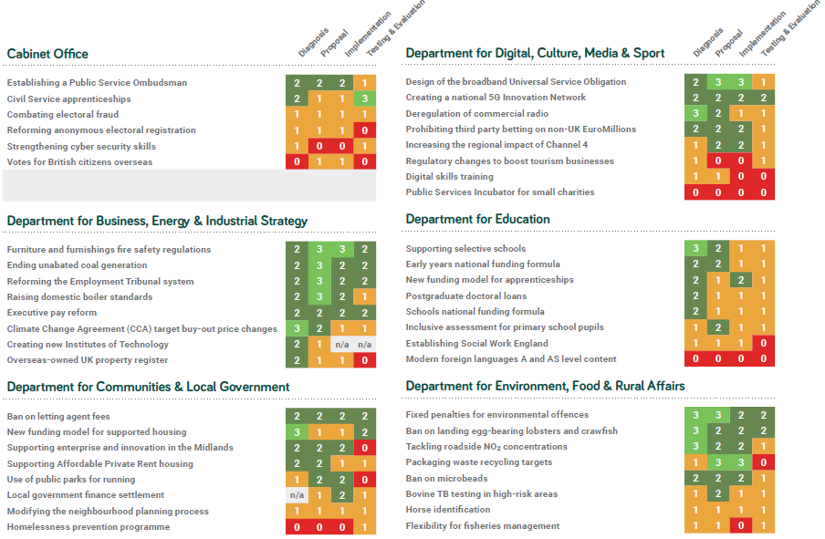

Slide 48
Pandemic politics
Epistemic trust/Recommendation trust
Matthew Bennett (2020) ‘Should I Do as I’m Told? Trust, Experts, and COVID-19’
Trust in the public
Overstepping/trade offs
Orthodoxy

Slide 49

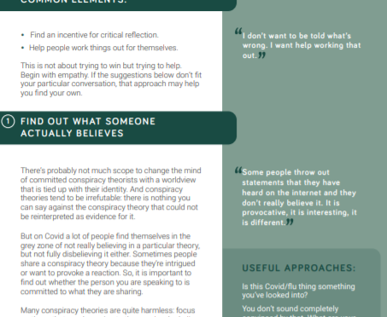
senseaboutscience.org/activities/talking-about-conspiracies/
Notes:
1. Sharing work done
Departments should make available (and clearly reference) the research and reviews that they have conducted
to inform a policy, so that the public can understand the rationale for it.
2. Poor referencing
Referencing needs to be more specific and useful. Some policies linked to significant documents, showed clearly
which points were referenced to which sources and how these were relevant to the government’s conclusions.
Most didn’t. We couldn’t locate guidance on referencing for government documents, which might help.
3. A clear chain of reasoning
People should be able to follow the thinking between Diagnosis, Proposal, Implementation and Testing
& Evaluation. The most transparent proposals demonstrated the chain of reasoning as to what the problem was
and why the policy was the chosen response, and included discussion about the limitations of the evidence.
4. Manifesto-derived policy commitments can be transparent
Policies that originated in manifesto commitments featured among the best and the worst for transparency.
This seems to have been influenced by whether they are concerned with outcomes (ends) or with specific
measures to achieve them (means), and whether departments consulted on their development.
5. Budget announcements
Policies announced in the Budget or Autumn Statement were significantly less transparent about the underlying
evidence than other policies.
6. Alternatives
There was very little transparency overall about the consideration given to other policy options, even though this
is a requirement in impact assessments.
7. Modelling policy impacts
Some departments have found clear and impressive ways to share their modelling and the assumptions
behind models.
8. Testing and evaluation
There is a lot of scope to improve the description of plans for testing and evaluation and for what consultations
will do with inputs. Few policies scored well on this. Policies with clear testing and evaluation plans tended to be
clearer about the evidence for the scope and scale of the issues they were addressing.

Slide 50
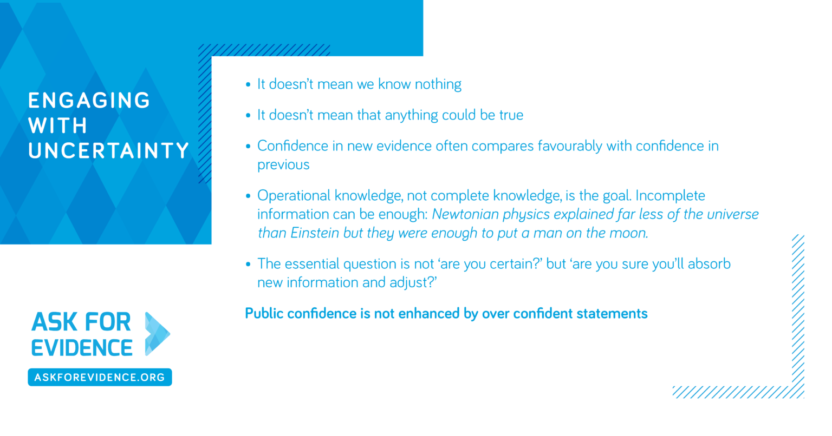

Slide 51
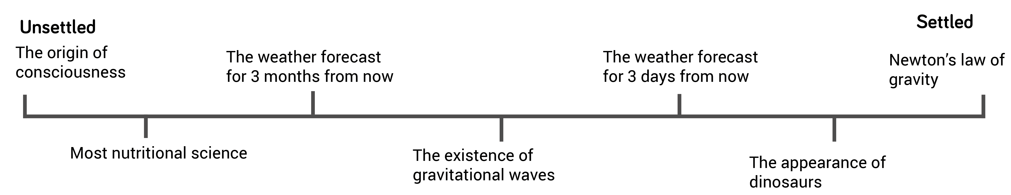
Understanding uncertainty

Slide 52
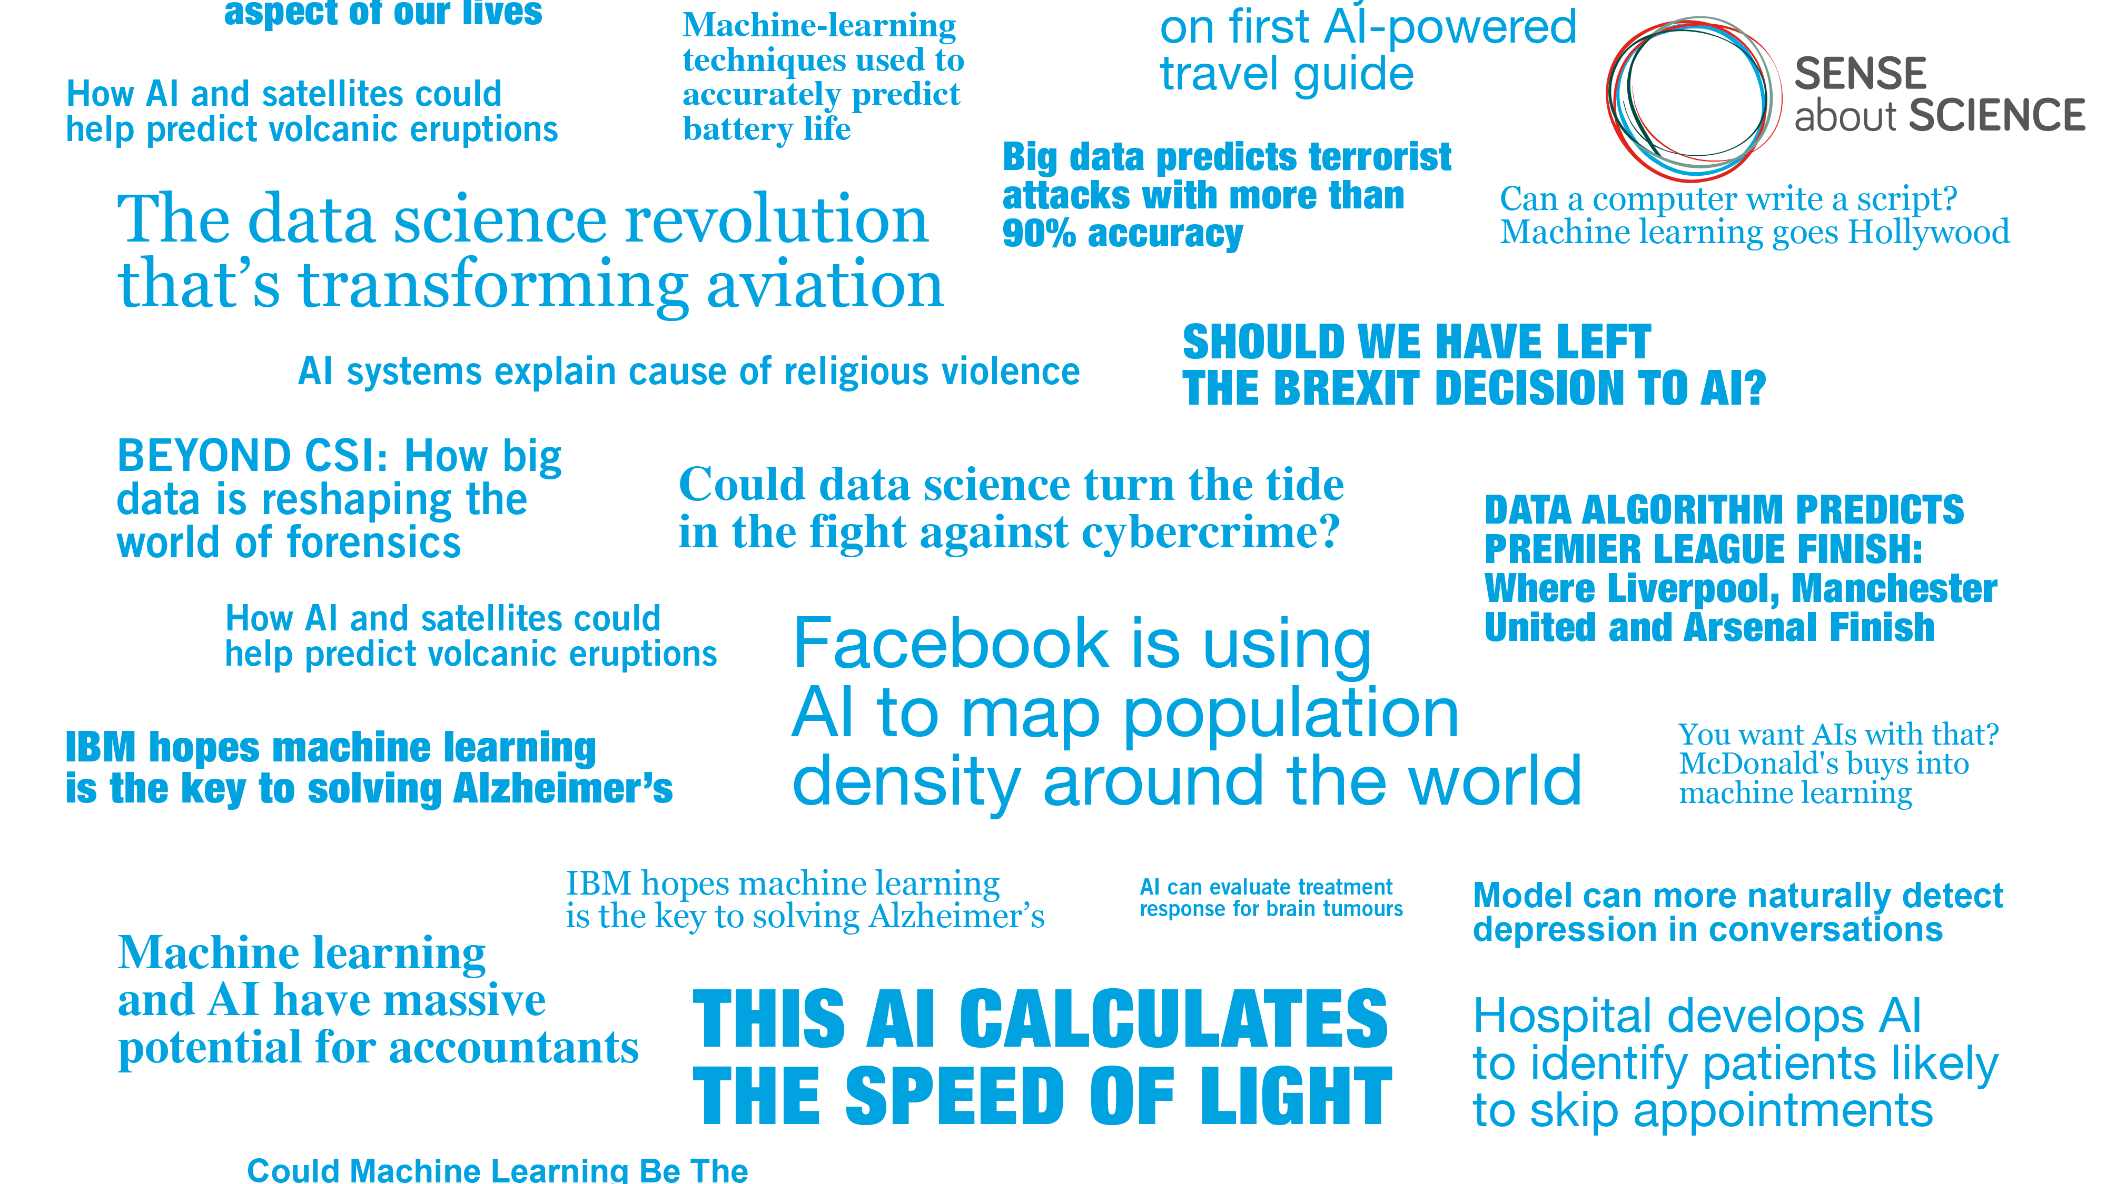
Notes:
Some interesting examples of predictions being made –
Machine learning to predict which YouTube videos will get ‘raided’ by hate speakers from 4chan.
Real-time psychosis risk calculation for clinicians – used ML algorithms to reveal predictors and how they interact with each other to give a risk score on screen to clinician as they input a patient’s details. E.g. gender, age at diagnosis, ethnicity, diagnosis index.
Allocation of jobs (cv sifting), freedom (likelihood of recidivism calculation for bail decisions) and resources (predicting food banks demand across UK to decide how to most effectively distribute resources)

Slide 53



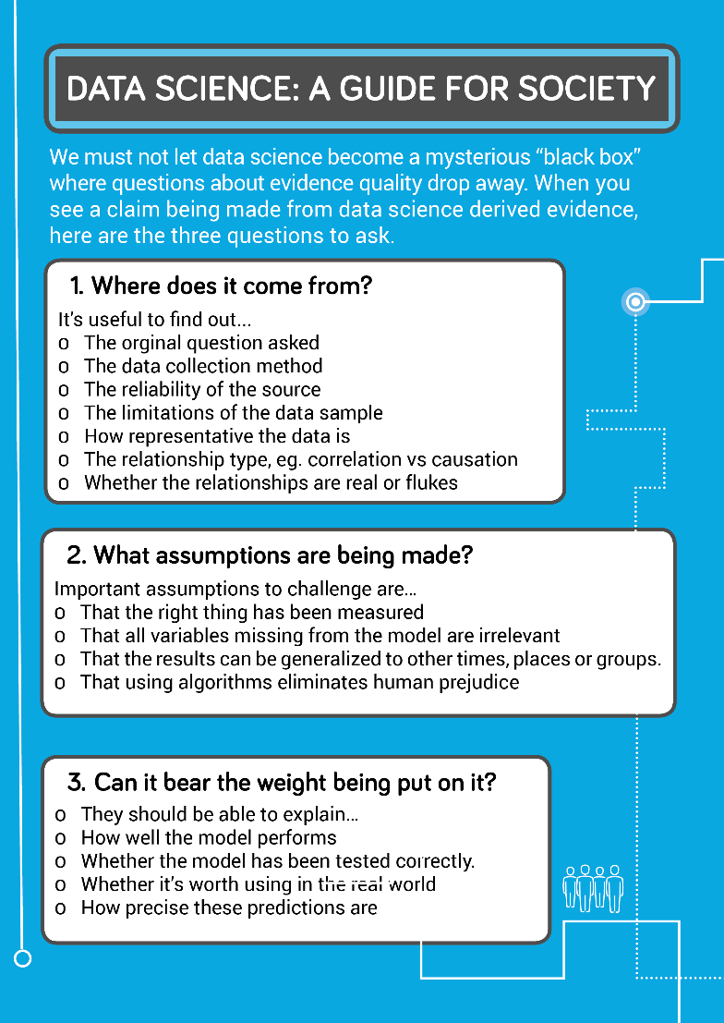
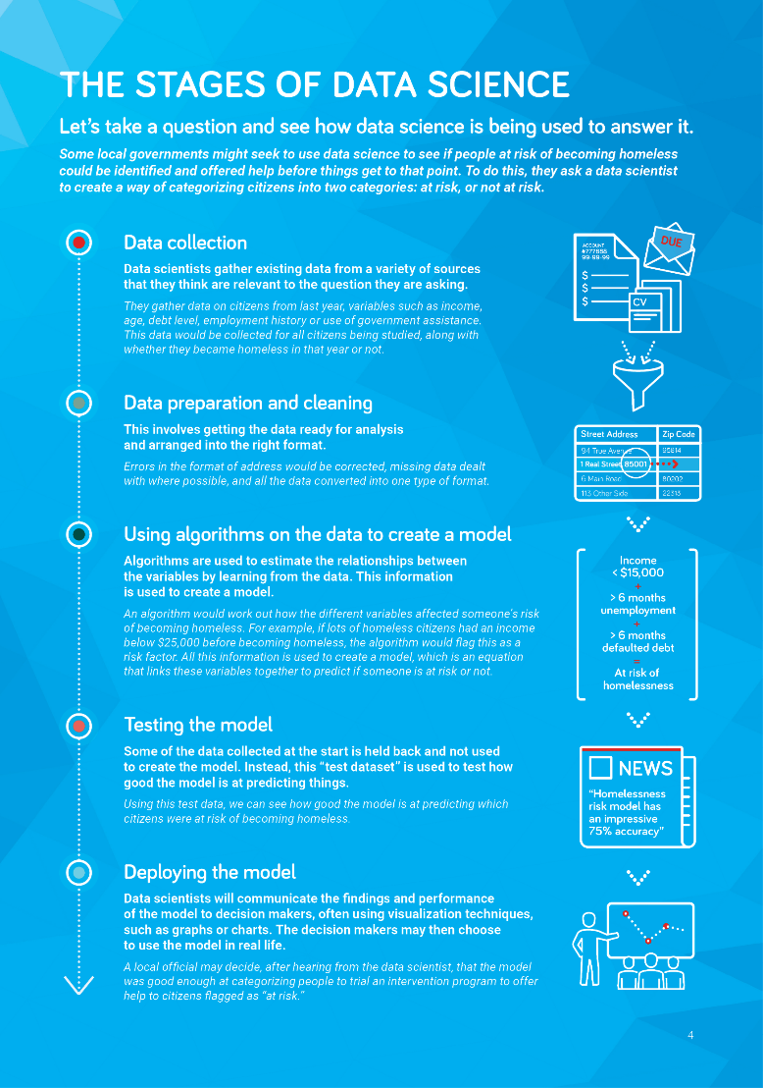
Notes:
Part of the problem is the inaccessible language, so this is where the guide begins, not to be a dictionary of terms, but to help non-data scientists understand enough about the language to understand and join a conversation. It then puts the language into context by running through a simple conceptual example to demonstrate the process/stages, which are referred back to throughout the guide. It then goes on to introduce 3 questions that people can ask to understand the level of quality and whether it is good enough to base decisions off.

Slide 54

1. Where does it come from?
2. What is being assumed?
3. Can it bear the weight being put on it?
#ResponsibleHandover

Slide 55
Socialise research integrity
Talk about research well done
Include the context
Challenge cynicism
Talk about limits
Equip the questions

Slide 57
Impact of Social Sciences, Humanities and Arts
13-15 October, 2021
Lorenzo Melchor Fernandez
Policy Analyst at the European Commission
#SSHA21

Slide 58
Nurturing science-for-policy ecosystems across Europe
A JRC perspective about
structures for evidence-informed policymaking
Lorenzo Melchor, PhD
Policy Analyst, Knowledge for Policy Unit
Joint Research Centre, European Commission
E: Lorenzo.Melchor-Fernandez@ec.europa.eu T: @DrLMelchor

Slide 59
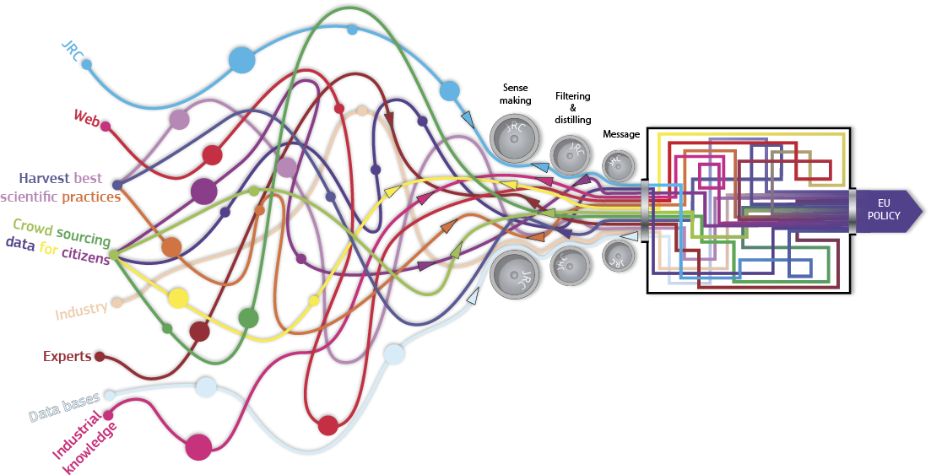
What the Joint Research Centre (JRC) is
The European Commission’s
knowledge and science service
Notes:
The JRC is the knowledge and science service of the European Commission.
As such, it is involved in producing science for policymaking, encompassing two different dimensions:
Knowledge production: >4,000 publications - ~700 peer reviewed journal articles & 70% of staff (total: ~2,700) working on research/knowledge projects
Knowledge management – knowledge for policy, i.e. “ensuring that the most useful and robust facts are provided and understood in good time for them to be taken into account by policymakers throughout the policy cycle”
This is all well and good but what happens in a crisis? When time is scarce, knowledge uncertain, information maybe overabundant. When stakes are high (we have just passed 200k Covid-19 deaths in Europe) and GDP ~15% lower than in the year before (Q2/2020 compared to Q2/2019).
The Covid-19 pandemic was indeed the ultimate stress test for science for policy structures and processes across Europe.

Slide 60
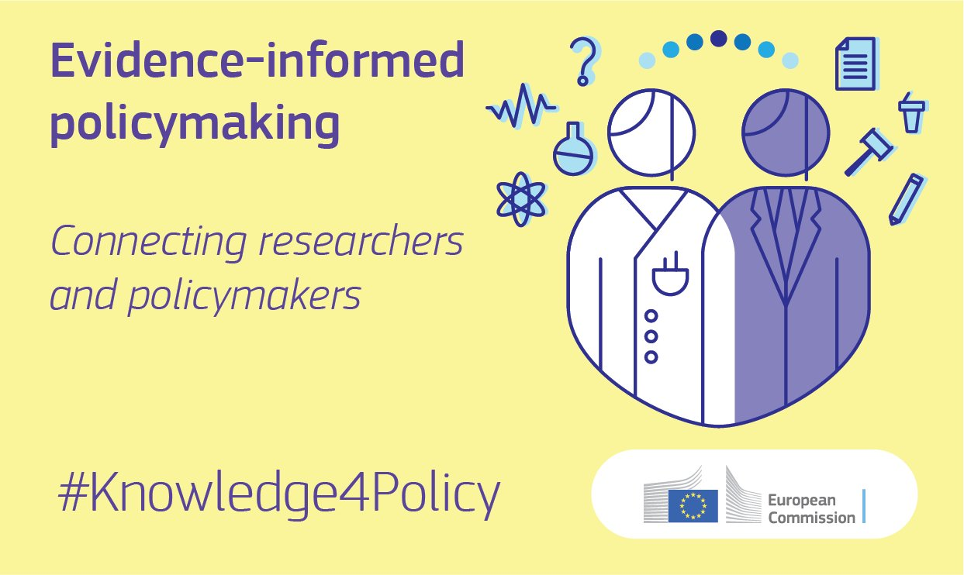

Slide 61

Evidence for effective policymaking?
Scientific evidence key input to effective policymaking
But is it that easy?
Stress test for role of science for policymaking:
Covid-19
Rigorous methods | Empirical data | Peer review
Ecosystem | Skills / mindsets | Limits
Evidence must reach decision-makers | Evidence must be understood by decision-makers | Evidence cannot give all the answers
Notes:
So that already tells you that I am convinced that scientific evidence is vital for designing and implementing effective policies. In fact, the scientific method has a number of benefits that other information do not, such as….
[see slide]
But as we had to learn ourselves and dedicated some time to study, it is not that straightforward.
Because evidence must reach decision-makers (institutional pathways)
Because evidence must be understood and valued by decision-makers (skills and mindsets on both sides)
Because there are limits as to what science can bring to policymaking.
Let me drill a bit deeper into this, using Covid-19 as the big stress test of science for policy, and also talk about JRC projects to resolve these challenges

Slide 62

How Covid-19 challenged science for policy ecosystems
Complexity uncertainty, and science production
Beyond science for policy: values, biases and citizens
Rapid demand for science and science for policy
ecosystem
Notes:
Why a stress test? Covid-19 basically challenged multiple dimensions of the science-policy interface
The complexity and uncertainty surrounding Covid-19 (new type of virus with unknown infection pathways, response of the public, effects on economy, unknown capacity of public health systems, and more) challenged science supply and production.
The rapid demand for scientific analysis and the need for scientific knowledge to be directly useful and quickly available tested the systems in place (or not) for connecting science and policymaking
Covid-19’s implications often touched upon different values and could be connected to different value positions held among policymakers and citizens, from economic livelihood of the less vulnerable versus health of the vulnerable to the protection of fundamental rights. As science assumed a more visible role in the Covid-19 discourse (“follow the science”), it came under greater public scrutiny and implicated in partisan, value-based controversies.
While not all of these challenges were necessarily novel, the crises shrank the time and space in which they had to be dealt with.

Slide 63
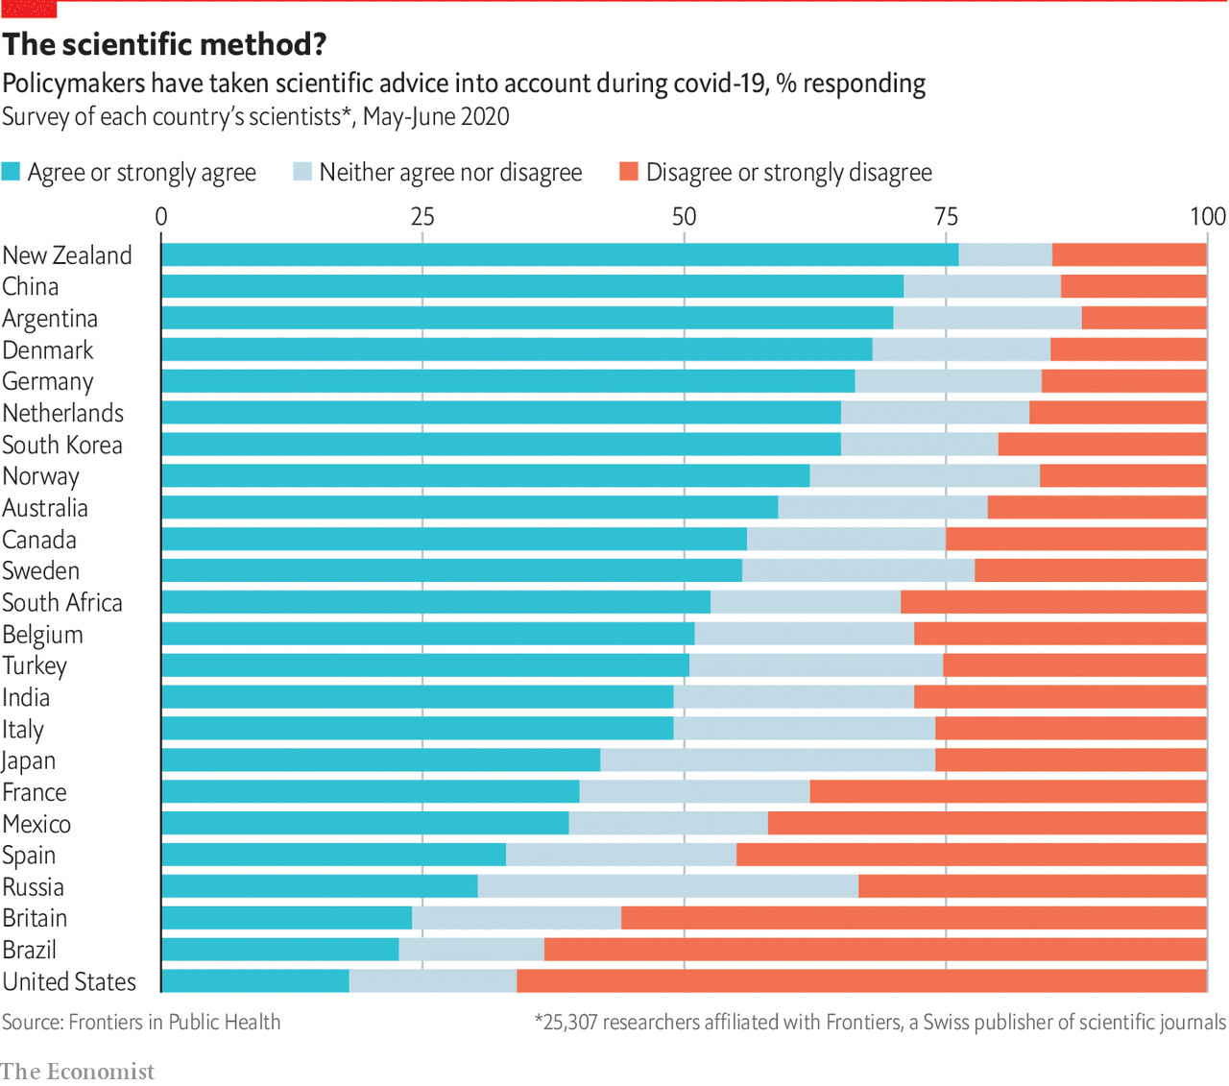
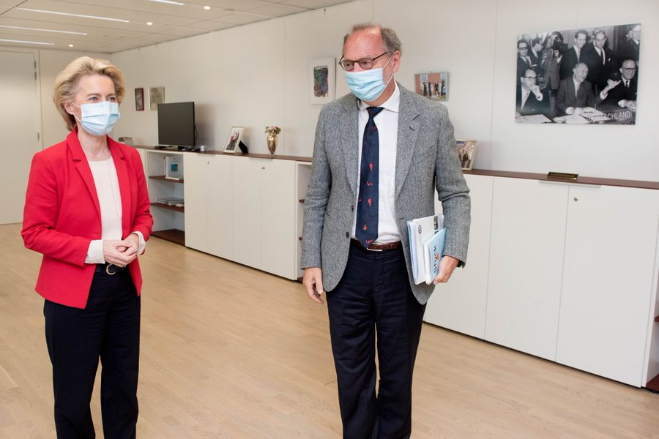
Meeting (more) often during Covid-19
Scientific evidence in high demand: epidemiological modelling, economic forecasting, testing kits, vaccines, behavioural science, and more
Notes:
Covid-19 is clearly a complex policy challenge – and one where science can really offer immense benefits to decision-makers. And this seems to have worked at first glance, judged by how visible scientists such as Pieter Piot and many others have become in the media, often standing right beside political leaders the world over.
And yet, a recently published global survey among scientists shows as how variable the uptake of scientific advice has been seen by the scientific community.
Moreover, policy responses often differed between countries even as scientific reviews and research is shared across borders.
We are still early in the middle of the crisis and lesson learning processes as regards to the role of scientific advice is only really beginning now – still, I would like to point to three points for consideration on how science can better contribute to effective policymaking.
IMAGE: tweeted by @vonderleyen: Good discussion with Peter Piot, our special advisor on #COVID19, on the evolution of the pandemic.We’re keeping a close eye on trends & remain committed to protecting our citizens. No complacency with the virus. Best chance remains the development of tests, treatments & vaccines 21/09/2020

Slide 64

Need for interdisciplinary evidence for policy
COVID-19 showed the:
Need to bring together different disciplines to address complex problems
Challenge of creating interdisciplinary evidence to inform policymaking
Need to liaise with complexity and uncertainty in science production and advice
JRC’s own Covid-19 response:
Creation of 80+ colleagues strong JRC task force from different areas and disciplines
Notes:
What Covid-19 has really shown is the challenge and importance for different disciplines to work together.
But how does this work? Is it enough to bring these disciplines into one room? How do we know whose expertise we need to resolve the numerous sub-challenges and who can be excluded to keep the discussions effective and manageable?
And who represents the different disciplines? And how can we ensure that the different pieces of science can be put together?
Some good practices emerged. National academies such as Germany’s Leopoldina organised multidisciplinary advisory councils. Our own JRC managed to get economists and epidemiologists to talk to each other and attempt to integrate their models. In both cases, an actor got involved that organised and helped translate these processes, the academy and a task force.
In other words, interdisciplinary work at short notice requires a certain level of organisational/procedural preparedness.

Slide 65



Paths for evidence-informed policymaking
Ecosystems
Skills and mindsets
Limits
Notes:
Nurturing science-for-policy ecosystems
Nurturing skills and mindsets for science for policy
Understanding the limits of science for policymaking

Slide 66
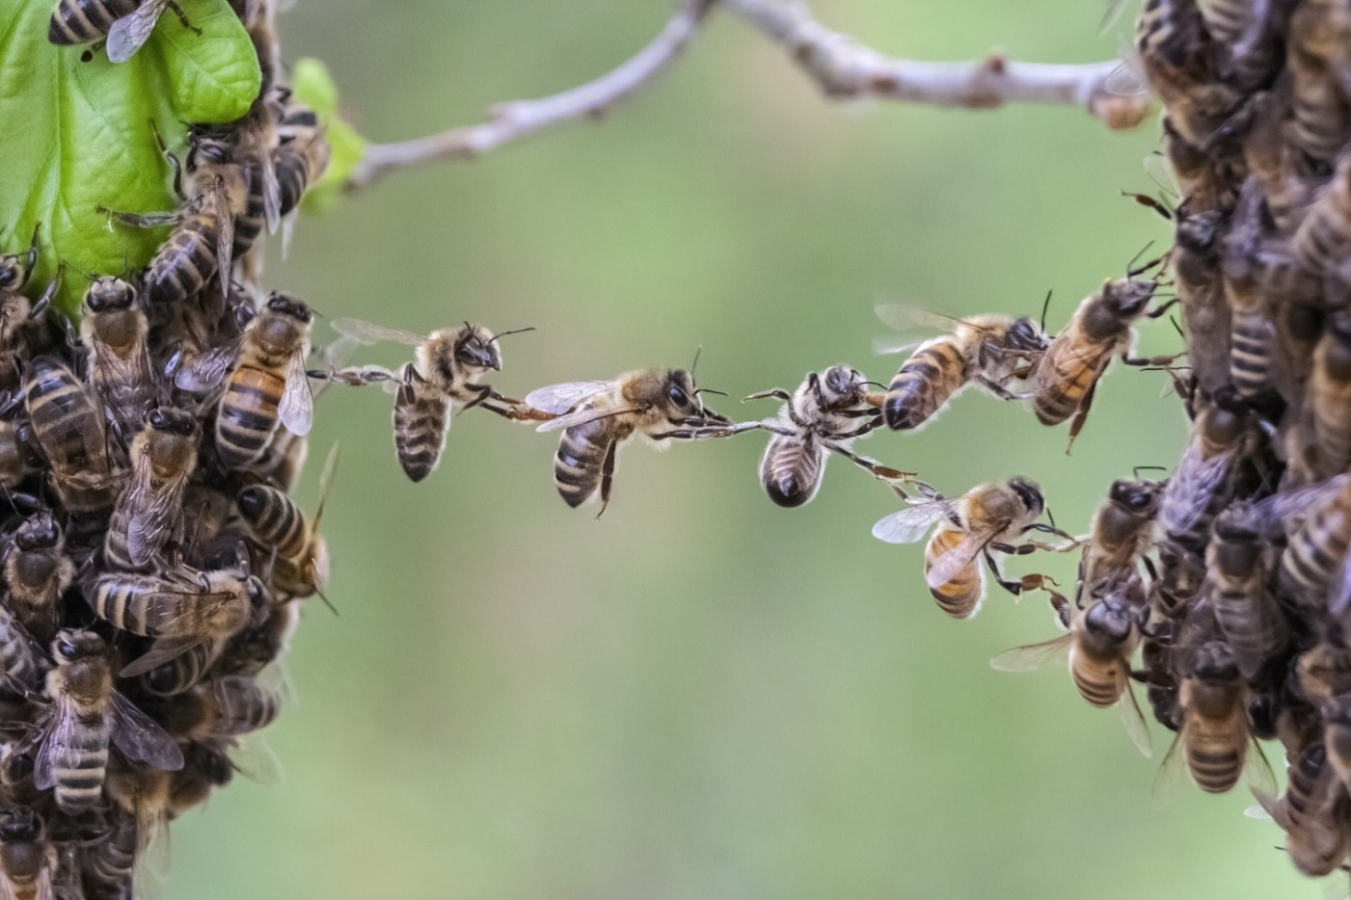
Prepare for urgency and scale at the science-policy interface
Need for robust science for policy eco-systems
Notes:
What the Covid-19 crisis also showed is that policymakers were really, especially in early spring, struggling with the level of uncertainty associated with Covid-19 pandemic and the pace with which the pandemic threatened to overwhelm societies’ response systems, and sought scientific advice but then also, as the scientific response rapidly exploded, to make sense of the importance, quality, and relevance of the available information.
Now different countries organised the supply, management and use of scientific evidence in different ways. Some used ad-hoc advisory bodies (Greece); others relied on existing structures (UK). Many also relied on international expertise (WHO, etc.). Yet, what seems useful is if well-defined relationships are in place, with high levels of trust between the two sides. Or the ability and experience to quickly create collaborative spaces involving representatives from both science and policymaking to understand quickly what’s needed and what can be provided.
In a nutshell, beyond institutional preparedness on the science supply side, we need an institutional preparedness at the science-policy interface that also for rapid, scalable evidence-informed responses to crises.

Slide 67

Science for policy ecosystems
Covid-19: Urgent call for multidisciplinary scientific input
Robust, internally and externally connected eco-systems of science for policy in place to respond?
  Quick mobilisation of expertise
  Mutual trust
  Knowledge brokerage across disciplines and between science & policy
JRC: Covid-19 lesson learning and pan-EU ‘ecosystem’ mapping projects still ongoing at JRC
Notes:
One building block needed seem to be robust, internally and externally connected ecosystems of science for policy.
Covid-19 resulted in an urgent call for multi-disciplinary scientific input in a highly uncertain situation. Institutional pathways connecting science and policymaking were helpful, including expert committees, councils, academies of science, knowledge for policy units on supply and demand sides, international networks, and more, could help
-mobilise expertise quickly
-increase essential trust between scientists/policymakers
-synthesise and translate scientific knowledge into policy-relevant evidence
Now not all countries with elaborate science for policy systems fared well and not all countries with slimmer systems fared poorly but to understand how this exactly worked is part of our ongoing analytical work on ‘eco-systems’ and Covid-19 lessons learning.

Slide 68


Science for policy ecosystems
The constellation of actors and individuals that foster communication between science- and policy-related environments
Boards or Councils
Industry
Offices of science & technology
Think tanks
Committees
Industry associations
Professional colleges
Unions
Data analysis units
National academies
Research centres
Universities
Working groups / task
Force teams
Foresight units
National observatories
Research libraries
Government research laboratories
NGOs
Regulatory agencies
Individual scientists
Learned societies
Science advisers
Notes:
The constellation of actors and individuals that foster communication between science- and policy-related environments (mostly governments and parliaments)
Importance of boundary organisations and knowledge brokers

Slide 69

Building institutional capacity for evidence-informed policymaking (EIPM)
12+ online interactive workshops
Mapping institutions and processes underpinning EIPM → SWOT analysis
Nurturing a community of practitioners (>600 members)
Surveying on qualities of ecosystems (>300 responses)
Co-creating capacity building projects
Notes:
This is for us, as science and knowledge service to the European Commission, water down our mill. In fact, we have been in the business of capacity building for science for policy even before COVID-19, also in relation to capacity at national and sub-national levels.
Much of this work, and I know that many of you have kindly contributed or participated in this project already, revolves around our Science for Policy workshop series.
What we have been doing since September 2020 is to organise 10 interactive, co-creation workshops to map science for policy ecosystems across Europe, finding out what works and not and run a survey among the 600 professionals in our community and beyond on qualities of science for policy institutions and processes.
The analytical work will hopefully help us provide evidence-based advice to partners in MS that hope to strengthen and connect science for policy ecosystems.
Now I just wanted to share two central lessons from our analytical work with you.

Slide 70

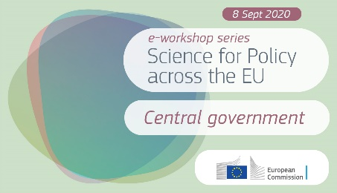


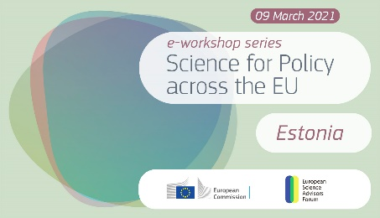


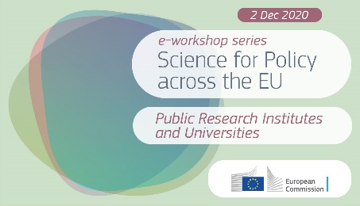

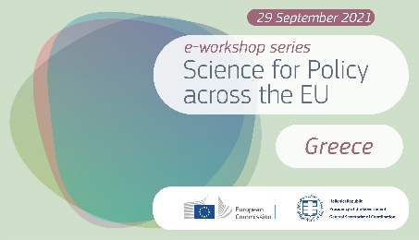

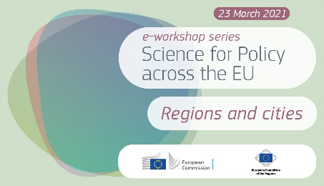
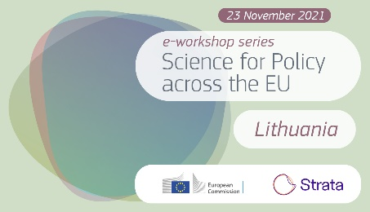
Ecosystems e-workshop series
Single element workshops
National ecosystem workshops
Notes:
This is for us, as science and knowledge service to the European Commission, water down our mill. In fact, we have been in the business of capacity building for science for policy even before COVID-19, also in relation to capacity at national and sub-national levels.
Much of this work, and I know that many of you have kindly contributed or participated in this project already, revolves around our Science for Policy workshop series.
What we have been doing since September 2020 is to organise 10 interactive, co-creation workshops to map science for policy ecosystems across Europe, finding out what works and not and run a survey among the 600 professionals in our community and beyond on qualities of science for policy institutions and processes.
The analytical work will hopefully help us provide evidence-based advice to partners in MS that hope to strengthen and connect science for policy ecosystems.
Now I just wanted to share two central lessons from our analytical work with you.

Slide 71
#1 Move from individual actors to ecosystems
Analytical blind spots
  Connections between actors?
  Complementarities between actors?
Competitive contracting
Missing the big picture
Notes:
First, it is important to move from an organisational perspective to a systematic one when evaluating and planning capacity building for science for policy / science advice institutions and processes
What we see is that focusing too much on individual actors creates certain analytical blind spots.
E.g. our workshop on academies suggested that they may have scientific authority (on the basis of their scientific excellence) and also strengths in assembling multi-disciplinary working groups but do they have sufficient resources to meet knowledge needs? And does the public trust the knowledge provided by these elitist, exclusive institutions?
Other actors therefore may assume a complementary role, e.g. young academies or government-funded research institutes?
In any case, it is important to bear in mind the limitations, complementarities, and competition between science advisory actors.
A focus on individual actors may also discount the importance of connections and coordination between the different actors – or maybe more accurately to what extent these connections are missing?
This view is also one factor that seems to be shaping capacity building debates and practice:
E.g. in Denmark, more than a decade ago, there was a relocation of science for policy from permanent integrated advisory bodies to universities and a competitive contracting process. While this has benefited the quality of science and also the connections between some ministries and universities, we heard in the workshop that this has also undermined knowledge brokerage quality on the supply side and the availability of a foundational knowledge base.

Slide 72

#2 Move from national ecosystems to networked European ones
Small countries cannot cover all knowledge needs
  Complementarities between actors?
Mutual- and peer-learning
Better regulation for the EU too
Notes:
A second central lesson, very briefly, is that the systems of Member States need to be connected to others in Europe.
As single actors cannot do everything, so do a single country’s systems. We heard in workshops on Latvia how the knowledge generation side cannot always cover the full range of knowledge needs of the government while we heard during our Estonia workshop how valuable international peer group reviews etc. can be.

Slide 73
Paths for evidence-informed policymaking
Ecosystems
Skills and mindsets
Limits
Notes:
Nurturing science-for-policy ecosystems
Nurturing skills and mindsets for science for policy
Understanding the limits of science for policymaking

Slide 74
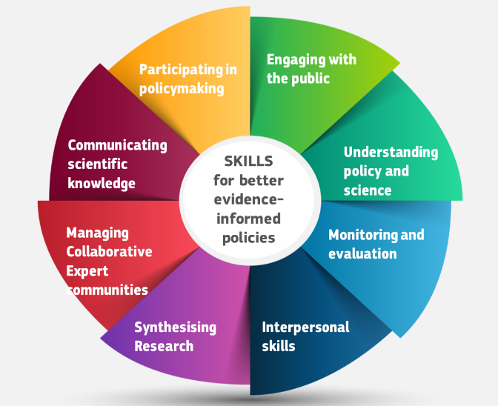
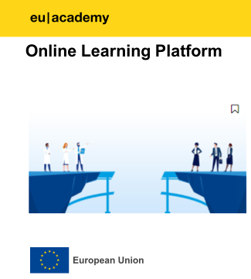


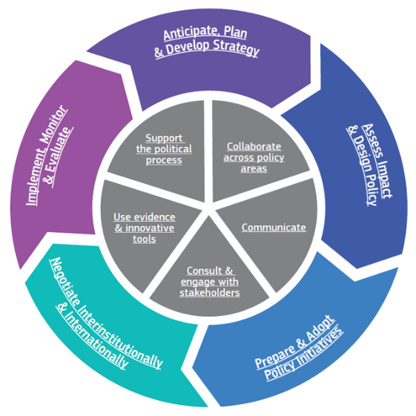

Individual capacity-building for skills & competencies for EIPM
For researchers:
Eight skills for scientists for knowledge mobilisation
Training courses online and offline
For policymakers:
Competency framework for policymakers (including skills for evidence use)
Launch of the EU policymaking hub
Notes:
Looking at institutions is not enough. We also need people with the right mindsets and skills in place in the different organisations involved, running the processes and interactions, and more.
Covid-19 revealed again how important this is. E.g. can policymakers make sense of epidemiological models? Do scientists understand the constraints on policymakers, needing to get members of the public accept the scientifically recommended necessary health protection measures?
This requires not only trust and institutionalised interactions but specific skills.
The JRC has been working on and offering relevant training modules for scientists and policymakers.

Slide 75
Paths for evidence-informed policymaking
Ecosystems
Skills and mindsets
Limits
Notes:
Nurturing science-for-policy ecosystems
Nurturing skills and mindsets for science for policy
Understanding the limits of science for policymaking

Slide 76
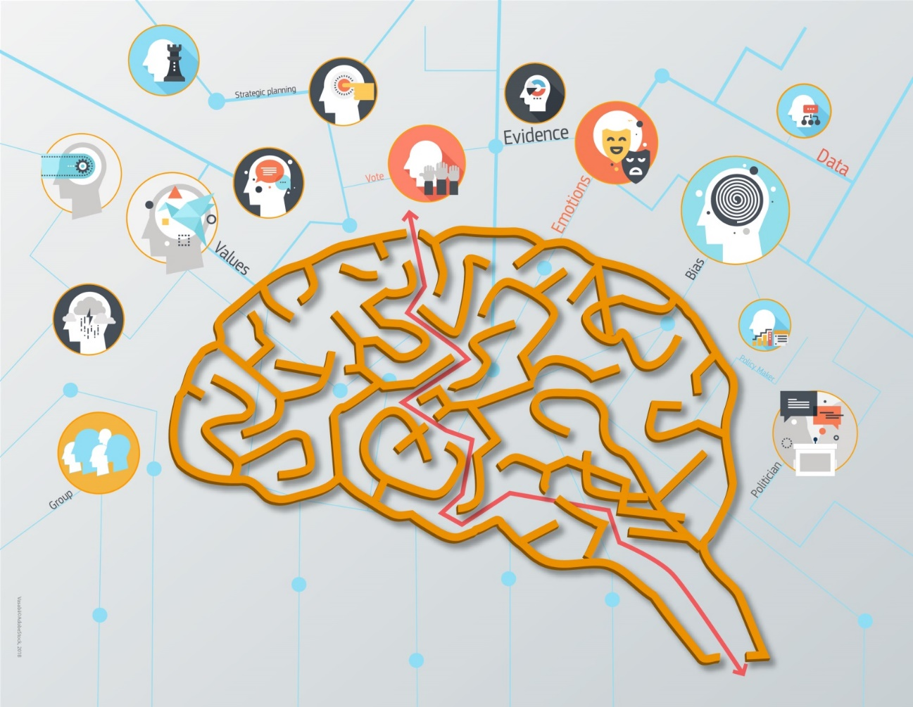
Prepare to look beyond science and policy
Crises cannot be resolved by science for policy alone
Notes:
Covid-19 has also once again shown the limits to science for policy. Covid-19 and the response to it affects different values in different manners. Economic livelihoods, freedoms, health are affected and have different importance to different groups in societies. When confronted with the same facts, citizens but also experts and policymakers can view them in different ways, assign different weights and credibility to, and draw different conclusions from different pieces of science.
Science for policy eco-systems need to develop a better understanding of these differences, either by exploring in greater depth different values and identities held by Europe’s citizens or by directly engaging with citizens and deliberating, e.g. about collectively acceptable Covid-19 responses and envisioning collectively how societies may need to be reorganised. One example for the former is the JRC’s work on Values and Identity and how it shapes political behaviour. One example for the latter is the Covid-19 citizen engagement process in Ireland.
These are questions still to be reflected on but it could become a third dimension of crisis preparedness for science for policy systems and activities in crisis.

Slide 77

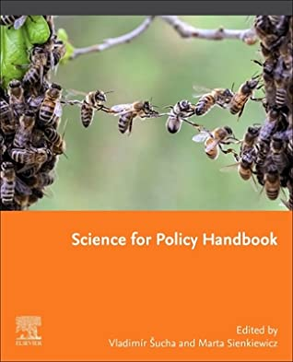

Limits to science for policy
Questions revealing limits:
  How to resolve value trade-offs (life, liberty, livelihood)
  How to respond to misinformation
  How to make legitimate decisions in a polarised society
  Can policymakers interpret models?
  Do scientists understand the need of public acceptance of measures?
Effective policies require legitimacy, which science can only provide to a limited degree
JRC: Engage with citizens & learn more about what shapes political behaviour
Notes:
Finally, I want to instil a bit of humility into the science for policy community and EIPM advocates – and open up the horizon for new types of issues this community should gather evidence on.
Science does not have all the answers:
>Covid-19 involved value trade-offs. Science cannot resolve them.
>Covid-19 also saw again the influence of misinformation. Scientific (counter)facts are not enough to respond.
>Covid-19 hit societies with different levels of polarisation. This affected how science was interpreted and used.
In a nutshell, it is good to ask how science can make policies more effective but it is equally important to understand that there are limits in what science can do to make policies legitimate. And legitimacy is key for policies to be effective.
The JRC is again working on these issues: by studying what factors shape political behaviour (beyond scientific evidence), e.g. values and identities, and how to better engage with citizens in policymaking processes.

Slide 78
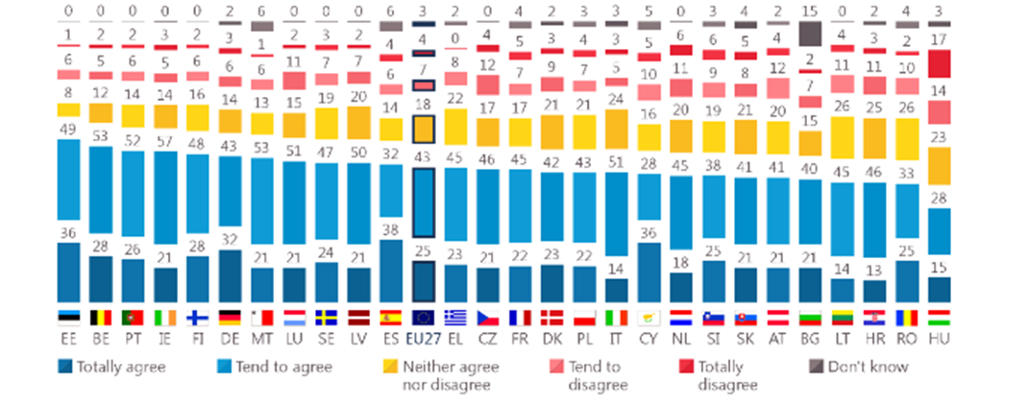
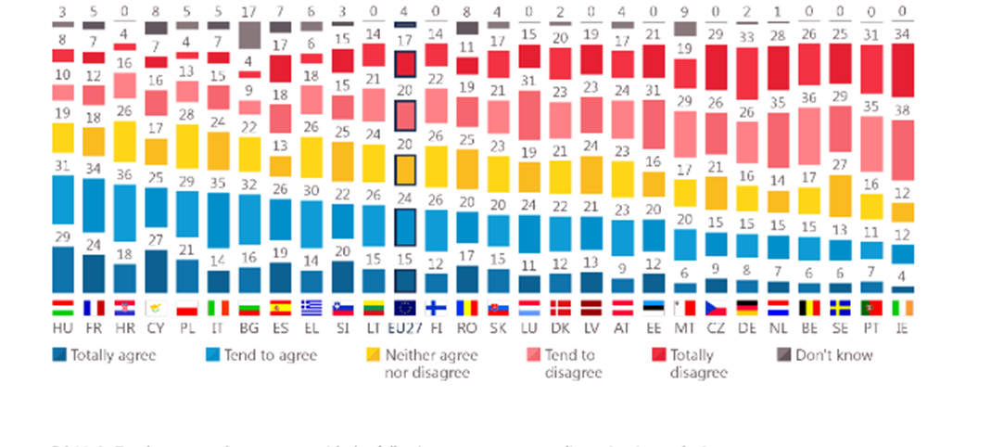
Citizens want scientists intervening in policy debate
68% of EU citizens agree with the sentence
Scientists should intervene in political debate to ensure
that decisions take into account scientific evidence
39% citizens agree with the sentence
Scientists should not intervene in political debate when
Decisions ignore scientific evidence
Eurobarometer of Science and Technology, Sept 2021

Slide 79
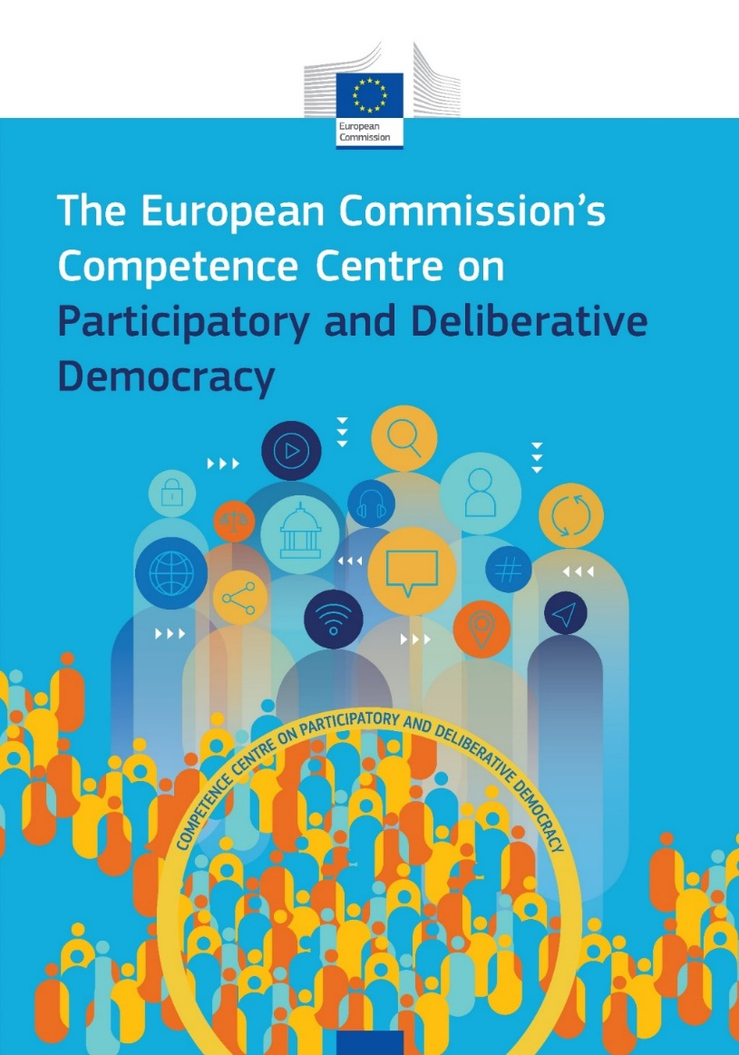
Engagement with citizens
CC-DEMOS
Knowledge Repository
Experimentarium
Capacity Building
Service
Community of Practice
Notes:
The new Competence Centre on Participatory and Deliberative Democracy is one of a group of dedicated JRC competence centres that aim to better connect science and policy in cross-cutting research areas. These are part branding, part knowledge management tools – places where policymakers with knowledge needs and researchers with useful expertise and knowledge can find each other. Typically the Competence Centres offer advice on the choice of tools in relation to the policy problems, training courses, and also work directly with the Commission policy Directorates-General to develop and/or apply the tools to the policy problems at hand. So, the Competence Centre on Participatory and Deliberative Democracy will thus act as a multifunctioning hub for EU services and policymakers to find the necessary expertise and tools to institutionalise and mainstream participatory and deliberative democracy practices. Competence Centres seek actively PARTNERSHIPS.
The CC-DEMOS can be described with 5 big containers that actually work together to support policy making in this area.
SERVICE: this is about guidance on HOW, namely though already ongoing:
Co-design, guidance, coaching of CE at request of Commission services
Piloting of CE: Where possible implementing citizen engagement on selected policy files with actually contributing to the design of citizen engagement
Specifications for a FWC – tools to allow others to work – WE ARE developing dedicated procurement provisions to ease the implementation process
But of course we provide also the rationales and the framings, and ensure that the Commission is up to date on developments of participatory and deliberative forms of governance around the world and in particular across institutions with a similar remit like ours.
KNOWLEDGE REPOSITORY: Enriching the EU knowledge base on participatory & deliberative practices that can inspire EC’s business when it comes to involve citizens across the policy making cycle. For example by:
Mapping of Deliberative Democracy and other citizen engagement initiatives across EU
Maintenance of live and interactive inventories which make visible Practices and practitioners, Citizen Engagement and Deliberative Democracy projects in the EU and CE online platforms inventory; we gained particular experience on this with our contribution to the choice and assessment of existing platforms out there.
Also, we are very interested on other places where citizen engagement is being organised; we describe these as places where people already go and intervene civically to change things of their concern. For this reason we also have a EU makerspaces inventory and we actually run a makerspace in Ispra.
BUILDING CAPACITY: We are building capacity on citizen engagement methodologies through regular trainings, coaching, toolkits and engagement exercises for colleagues in policy DGs.
NETWORKING: Events – own, e.g. festival; our third festival was very well attended by our Cmmsr. Gabriel and two vice-presidents: Vera Jourova and Dubravka Suica. We also have planned thematic workshops with members’ events of the CoP and we pursue Collabs. with other organisations, such as OECD, but also museums and libraries and other places that can act as partners to carry out the engagements.
EXPERIMENTARIUM: Experimenting with new methodologies, including trialling public spaces for citizen engagement.
Evaluation frameworks - we are also setting up evaluation frameworks to assess the quality of the engagement activities in Commission remit.
Piloting of innovative CE methodologies
Spaces [e.g. makerspaces]

Slide 80
Conclusions
Scientific evidence key to delivering effective policies
EIPM requires:
  Science for policy ecosystems with active mechanisms and processes
  Key role of boundary organisations → need for institutional capacity building
  Key role of knowledge mobilisers → need for individual capacity building
  limits to what science can do to create more effective policies
JRC works on improving the understanding of the challenges to evidence for policy and developing tools to address them
Covid-19 is offering interesting lessons for science for policy

Slide 81

Thank you
© European Union 2020
Unless otherwise noted the reuse of this presentation is authorised under the CC BY 4.0 license. For any use or reproduction of elements that are not owned by the EU, permission may need to be sought directly from the respective right holders.
Slide xx: element concerned, source: e.g. Fotolia.com; Slide xx: element concerned, source: e.g. iStock.com
Notes:
Update/add/delete parts of the copy right notice where appropriate.
More information: https://myintracomm.ec.europa.eu/corp/intellectual-property/Documents/2019_Reuse-guidelines%28CC-BY%29.pdf

Slide 82








Keep in touch
ec.europa.eu/
europeancommission
europa.eu/
@EuropeanCommission
@EU_Commission
EUTube
@EuropeanCommission
EU Spotify
European Commission
Notes:
Delete/update as appropriate

Slide 83

Reuse Guidelines
Using Creative Commons licenses for the distribution and reuse of Commission presentations
A slide appearing at the end of the presentation should include a CC license notice:
If third-party works (e.g. an illustration to which the EU does not own the copyright, but for which we have a license) are included, this slide should also mention them:
© European Union 2020
Reuse of this presentation authorised
under the CC BY 4.0 license.
Except where otherwise noted, this presentation is © European Union and is licensed under the CC BY 4.0 license.
Slide xx: “Name of graphic” (web link to graphic) by name of author/creator is licensed under CC BY 4.0 (https://creativecommons.org/licenses/by/4.0/)
More detailed information on Creative Commons can be found here.

Slide 84
JRC Resources
Science for Policy Handbook (2020)
Technology and Democracy (2020)
Understanding our Political Nature (2019)
Science for Policy Eco-systems workshops (2020-21)
JRC scientific response Covid-19

Slide 85

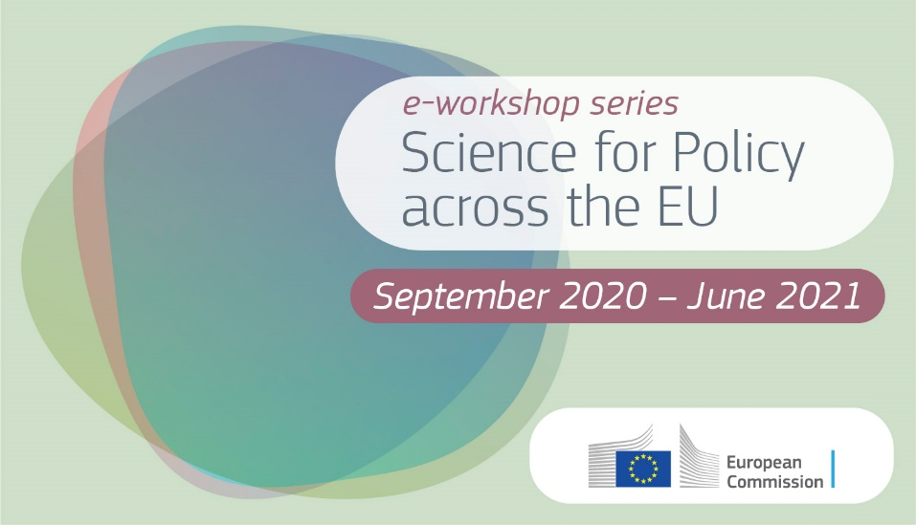
Meeting in different places
Institutionalised and ad-hoc advisory groups
Science academies
Science-policy fellowship schemes
Science advisors in ministries / to government
Scientific service to government / Parliament
Agencies
Parliamentary hearings
Lessons learned:
No one-size-fits-all
Awareness and coordination among science for policy actors and processes key for effectiveness, within one country and across borders

Slide 86
Impact of Social Sciences, Humanities and Arts
13-15 October, 2021
Thank you!
#SSHA21

